Slide 1
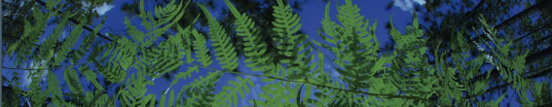

Workshop Setup
University of Florida

Slide 2
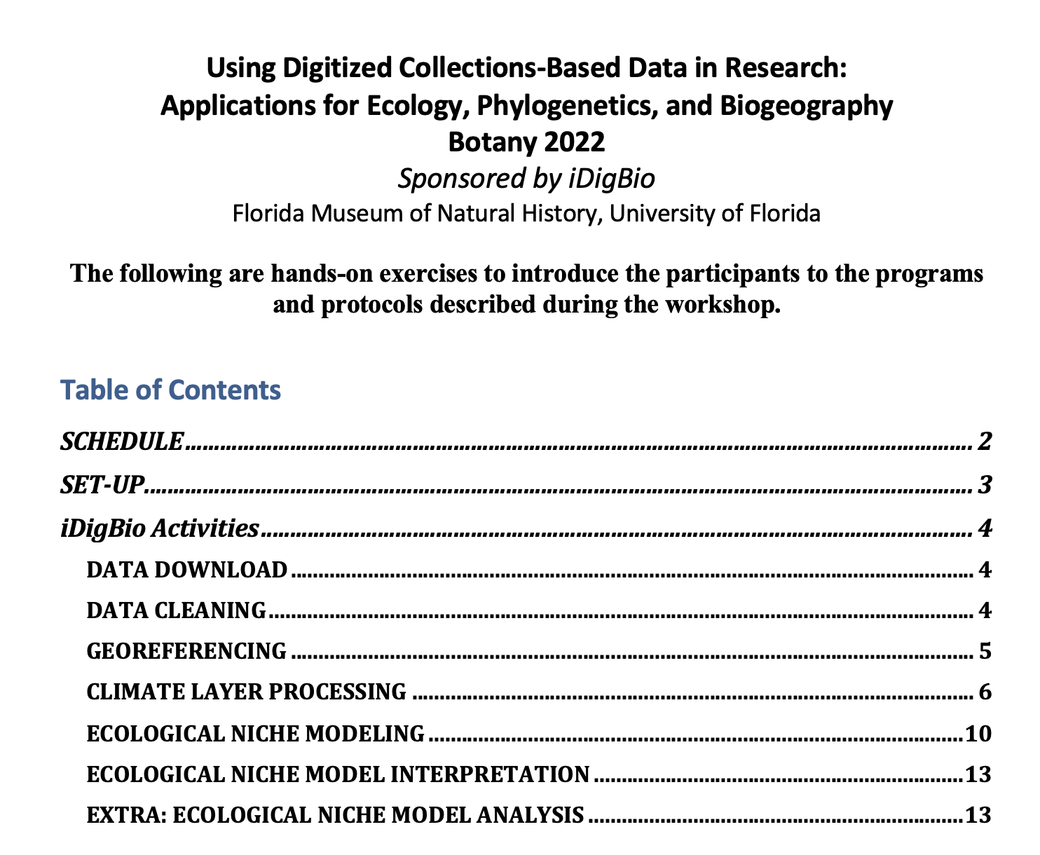
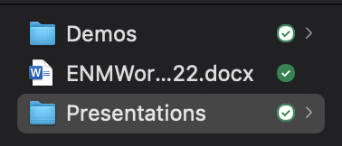
Workshop setup
Workshop Guide
Questions can be added here
during and after the workshop:

Slide 3
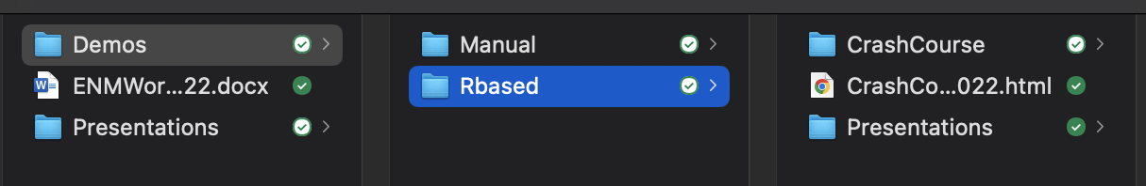
Workshop setup
HTML Version of all R scripts

Slide 4
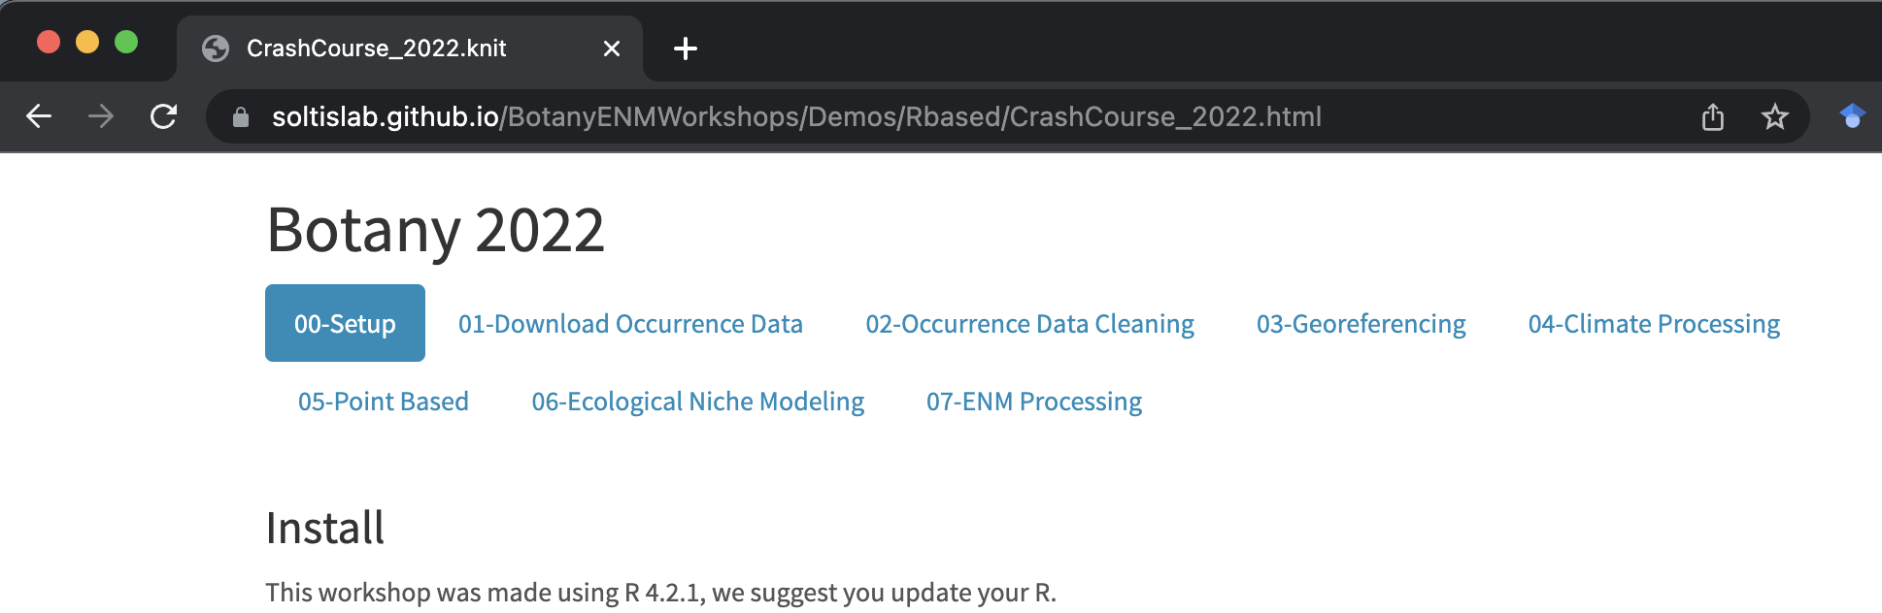
Workshop setup
https://tinyurl.com/4nk7zcws
Contains additional troubleshooting steps
Notes:
Great way to follow along during the workshop!

Slide 5
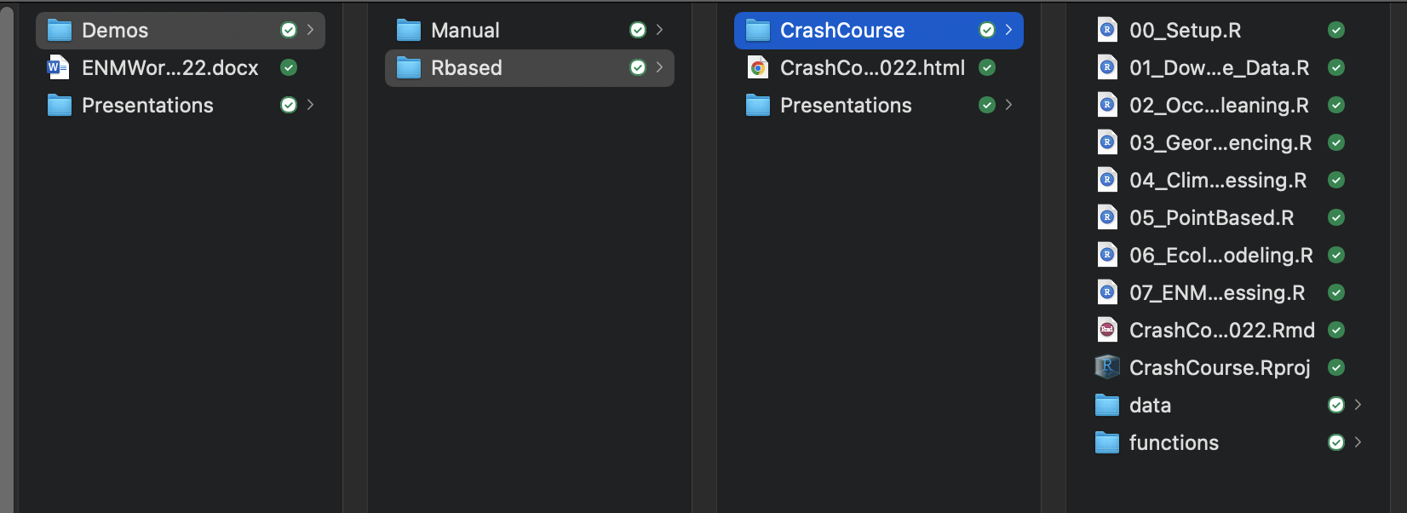
Workshop setup
Opens the R project

Slide 6
Workshop setup
Run before the workshop started!
How the R project was made
All data and functions needed for these scripts

Slide 7
01-Data Download
University of Florida

Slide 8
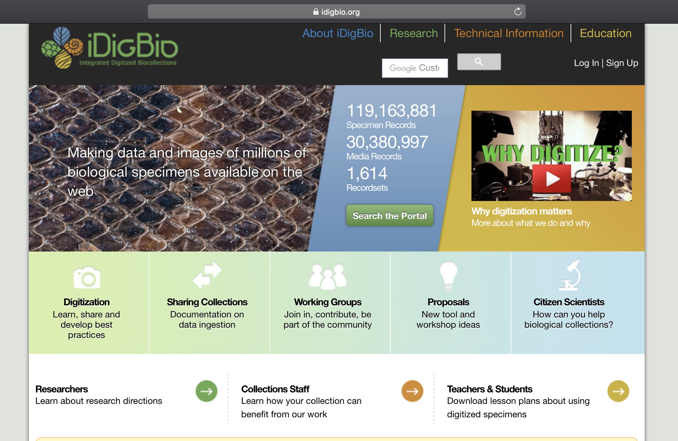

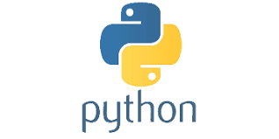
API = Application Programming Interface
Allows users to interact with a system
Web portal
API
Database
Interface

Slide 9
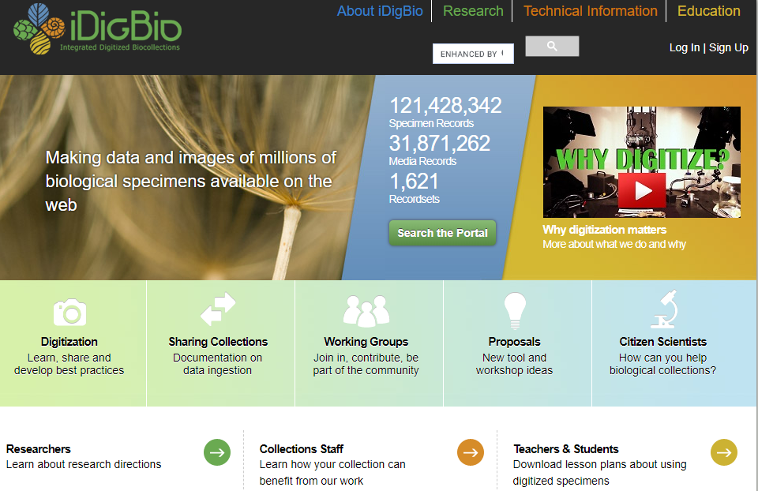

Slide 10

iDigBio API
Multiple ways to access the API:
API Name | Info
Search API | ridigbio R package <100,000 records
Download API | >100,000 records
Record API | Single record
Media API | Single record
biodiversity-specimen-data/specimen-data-use-case

Slide 11
iDigBio API
Multiple ways to access the API:
API Name | Info
Search API | ridigbio R package <100,000 records
Download API | >100,000 records
Record API | Single record
Media API | Single record
biodiversity-specimen-data/specimen-data-use-case

Slide 12
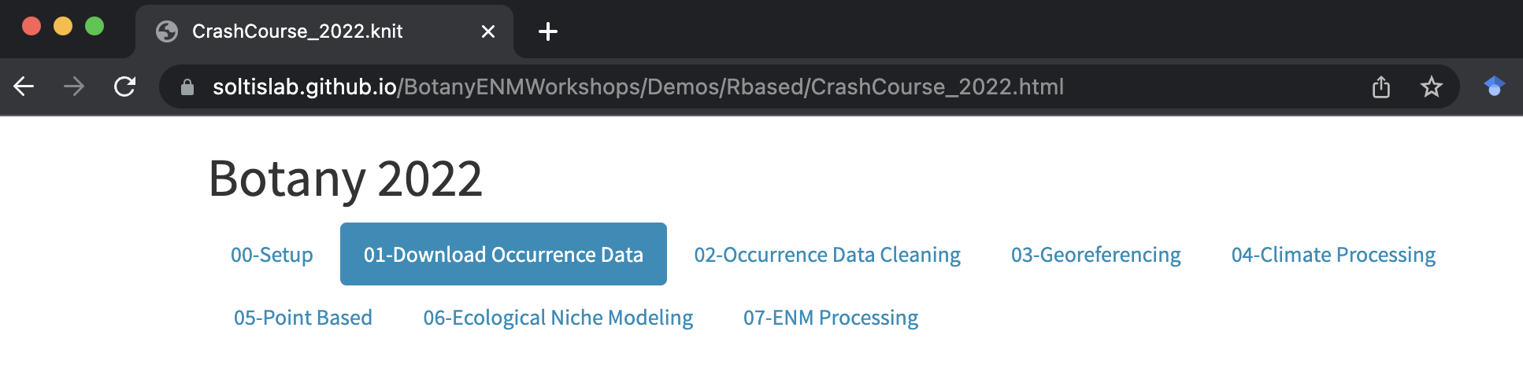
R based
https://tinyurl.com/4nk7zcws
“Demo/Rbased/CrashCourse/CrashCourse.Rproj”
Navigate to 01_Download_Occurence_Data.R

Slide 13
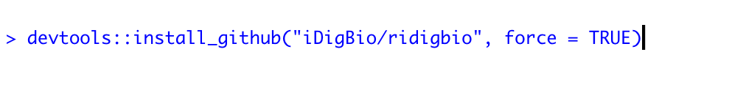
Correction

Slide 14
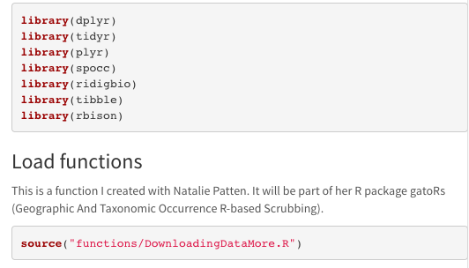





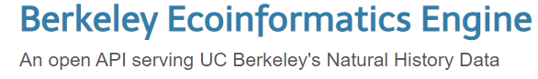
Load Packages
Notes:
spocc- Global Biodiversity Information Facility ('GBIF'), 'USGSs' Biodiversity Information Serving Our Nation ('BISON'), 'iNaturalist', Berkeley 'Ecoinformatics' Engine, 'eBird', Integrated Digitized 'Biocollections' ('iDigBio'), 'VertNet', Ocean 'Biogeographic' Information System ('OBIS'), and Atlas of Living Australia ('ALA'). Includes functionality for retrieving species occurrence data, and combining those data.
Ridigbio-Interface to the iDigBio Data API

Slide 15
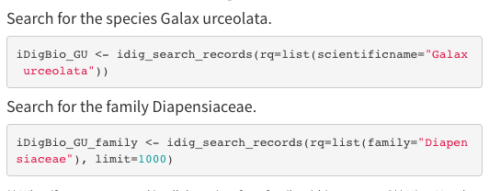
Downloading data using ridigbio
First, we are searching for the species Galax urceolata
Next, download occurrence records for the family Diapensiaceae

Slide 16
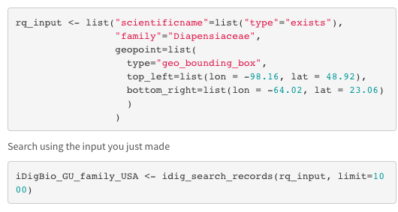
Records only in North America

Slide 17







Data download using spocc_combine
To pull data from GBIF, BISON, and iDigBio for a set of synonyms
Identifying synonyms:
Taxonomic Name Resolution Service
https://tnrs.biendata.org/
Used in soltislab/BotanyENMWorkshops 2020
R package taxize
20 sources for synonyms
https://docs.ropensci.org/taxize/

Slide 18
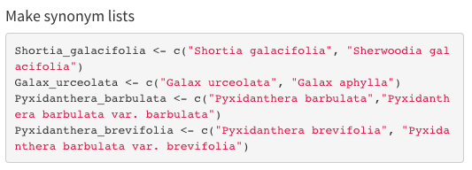
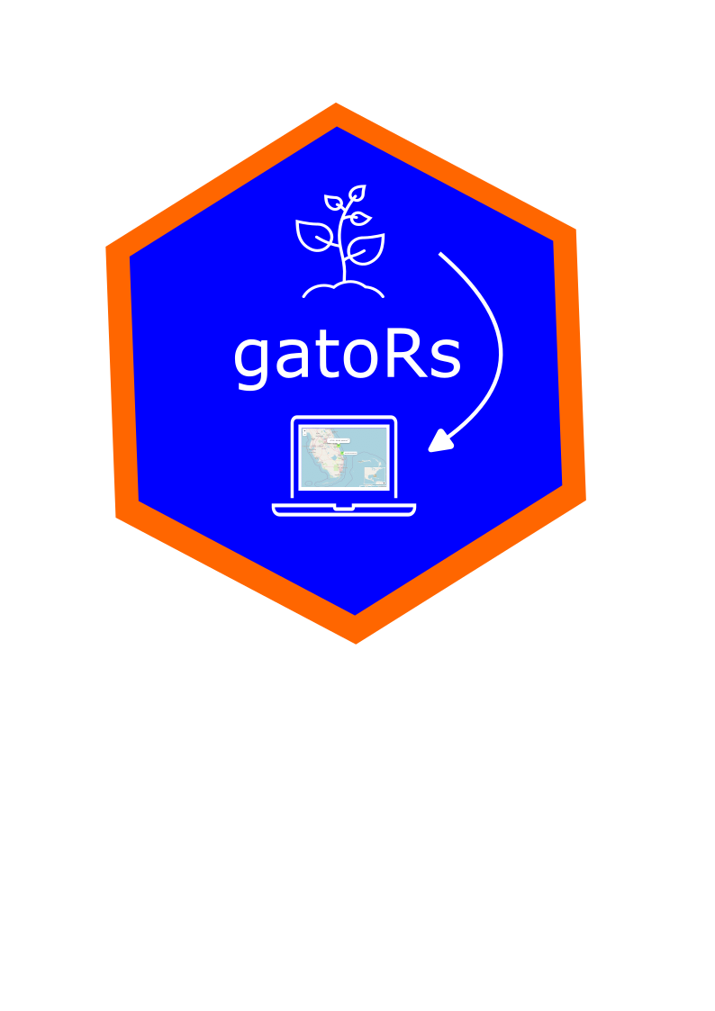
Data download using spocc_combine
Object
List of strings

Slide 19
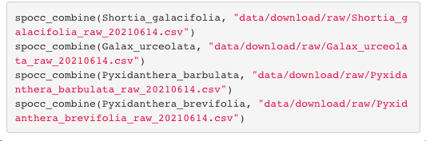
Data download using spocc_combine
(
Synonym list
,
Path to save csv file
)
spocc_combine

Slide 20
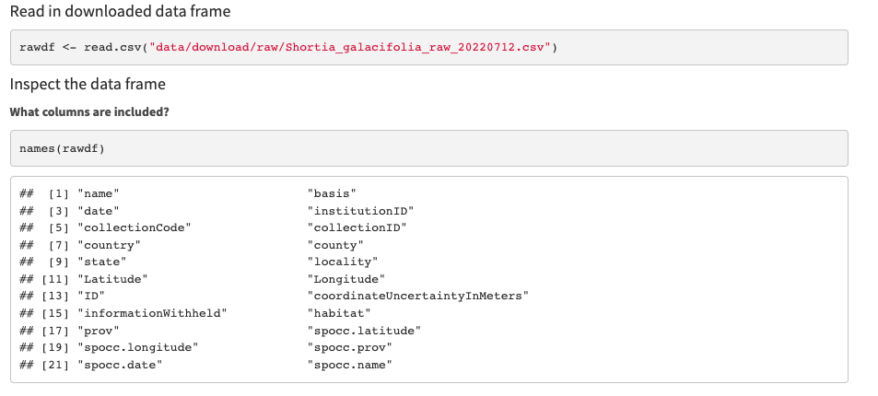
Quick-look at downloaded files

Slide 21
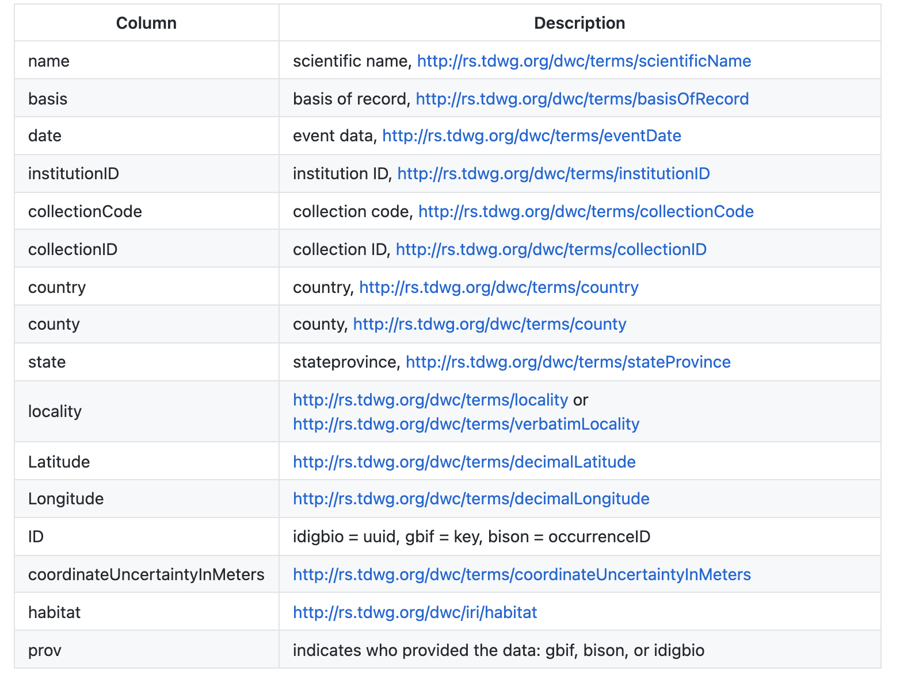

Slide 22
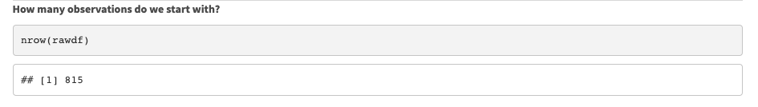
Quick-look at downloaded files

Slide 23
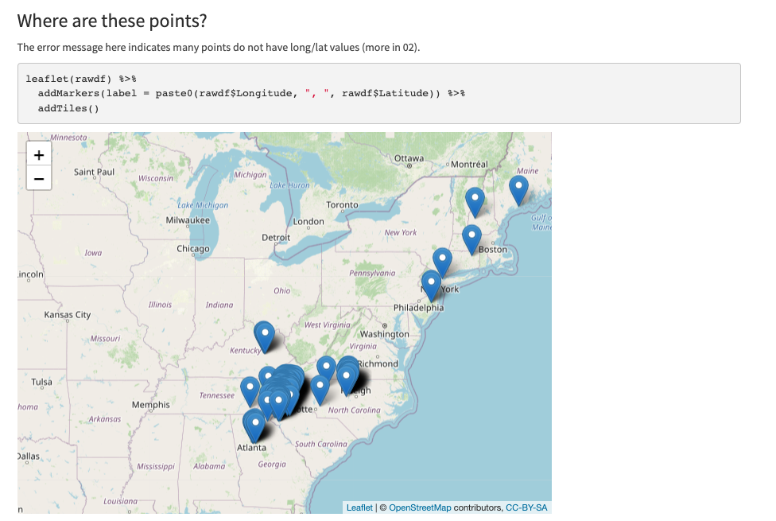

Slide 24
Other considerations:
Download from multiple repositories
Identify flagged data
Identify data for georeferencing

Slide 25
Other considerations:
Download from multiple repositories
Identify flagged data
Identify data for georeferencing
Patten et al. In prep. gatoRs: Geographic and Taxonomic Occurrence R-Based Scrubbing. nataliepatten/gatoRs

